Slide 1
Overview of the Olympic Games
Brief history and significance of the Olympics.
Presented By:
Omid Khan
Evan Wall
Grant Itow
Notes:
Slide 1: Introduction to Olympic Medal Trends
Talking Points:
Welcome everyone to the presentation. Today, we'll explore how global events, economic factors, and population have influenced the Olympic medal counts over the years.
The Olympics have always been more than just a sporting event; they've been a stage for global power dynamics, economic prowess, and cultural influence.
Script:
"Good [morning/afternoon], everyone. Thank you for joining today's discussion on the trends in Olympic medal counts over the years. We'll dive into how geopolitics, economic strength, and population sizes have shaped the competition at the Summer Olympics. The Olympics, since their modern inception, have often mirrored the political and economic climates of their time, serving as a microcosm of global power dynamics."
Slide 1: Introduction to Olympic Medal Trends
Talking Points:
Welcome everyone to the presentation. Today, we'll explore how global events, economic factors, and population have influenced the Olympic medal counts over the years.
The Olympics have always been more than just a sporting event; they've been a stage for global power dynamics, economic prowess, and cultural influence.
Script:
"Good [morning/afternoon], everyone. Thank you for joining today's discussion on the trends in Olympic medal counts over the years. We'll dive into how geopolitics, economic strength, and population sizes have shaped the competition at the Summer Olympics. The Olympics, since their modern inception, have often mirrored the political and economic climates of their time, serving as a microcosm of global power dynamics."
Slide 1: Introduction to Olympic Medal Trends
Talking Points:
Welcome everyone to the presentation. Today, we'll explore how global events, economic factors, and population have influenced the Olympic medal counts over the years.
The Olympics have always been more than just a sporting event; they've been a stage for global power dynamics, economic prowess, and cultural influence.
Script:
"Good [morning/afternoon], everyone. Thank you for joining today's discussion on the trends in Olympic medal counts over the years. We'll dive into how geopolitics, economic strength, and population sizes have shaped the competition at the Summer Olympics. The Olympics, since their modern inception, have often mirrored the political and economic climates of their time, serving as a microcosm of global power dynamics."
Slide 1: Introduction to Olympic Medal Trends
Talking Points:
Welcome everyone to the presentation. Today, we'll explore how global events, economic factors, and population have influenced the Olympic medal counts over the years.
The Olympics have always been more than just a sporting event; they've been a stage for global power dynamics, economic prowess, and cultural influence.
Script:
"Good [morning/afternoon], everyone. Thank you for joining today's discussion on the trends in Olympic medal counts over the years. We'll dive into how geopolitics, economic strength, and population sizes have shaped the competition at the Summer Olympics. The Olympics, since their modern inception, have often mirrored the political and economic climates of their time, serving as a microcosm of global power dynamics."

Slide 2
From Dominance to Division: Olympic Medal Trends Before and After the Fall of the Berlin Wall
Pre-WWII, Germany was a major force in the Olympics, hosting the 1936 Games in Berlin.
Post-WWII, Germany was banned from the 1948 Olympics due to the war.
The split into East and West Germany led to separate teams and competition until reunification in 1990.
Notes:
Introduce the dataset, and explain that the presentation will analyze Olympic medal counts in two distinct periods: before and after the Berlin Wall’s fall in 1989.
Pose the central question: How did global politics and emerging powers shape Olympic performance during these times?

Slide 3
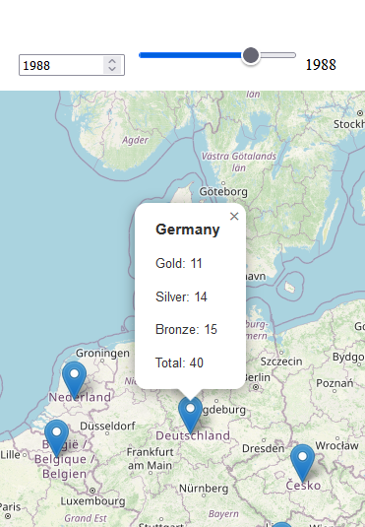
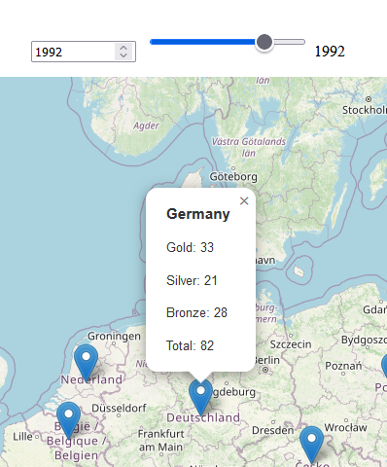
The Fall of the Berlin Wall and Its Immediate Impact (1989–1992)
The geopolitical transformation after 1989 and how it reshaped the Olympics.
Before and After: Shows the shift in medal distribution after the fall of the Berlin Wall and the collapse of the USSR in 1991.
Notes:
The breakup of the Soviet Union and the fall of the Berlin Wall led to the emergence of new medal-contending nations in the 1992 Olympics and beyond.

Slide 4
Impact of World War II on Germany's Olympic Performance
Pre-WWII, Germany was a major force in the Olympics, hosting the 1936 Games in Berlin.
Post-WWII, Germany was banned from the 1948 Olympics due to the war.
The split into East and West Germany led to separate teams and competition until reunification in 1990.
Notes:
New powers, particularly China, began to dominate the medal counts in the post-Cold War era, shifting the global balance of Olympic success.

Slide 5
Cold War Rivalry - USA vs. Soviet Union
The Olympics became a battleground for ideological dominance between the USA and the Soviet Union.
Political boycotts in 1980 (Moscow) and 1984 (Los Angeles) highlighted tensions.
The competition was not just about sports; it was about proving the superiority of political systems.

Slide 6
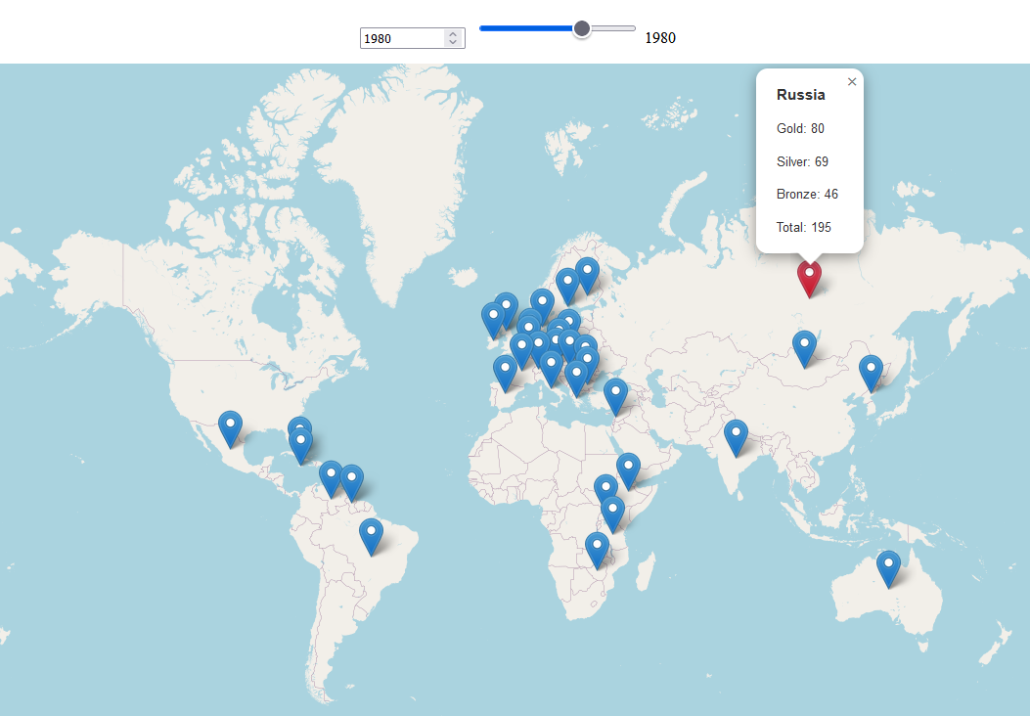
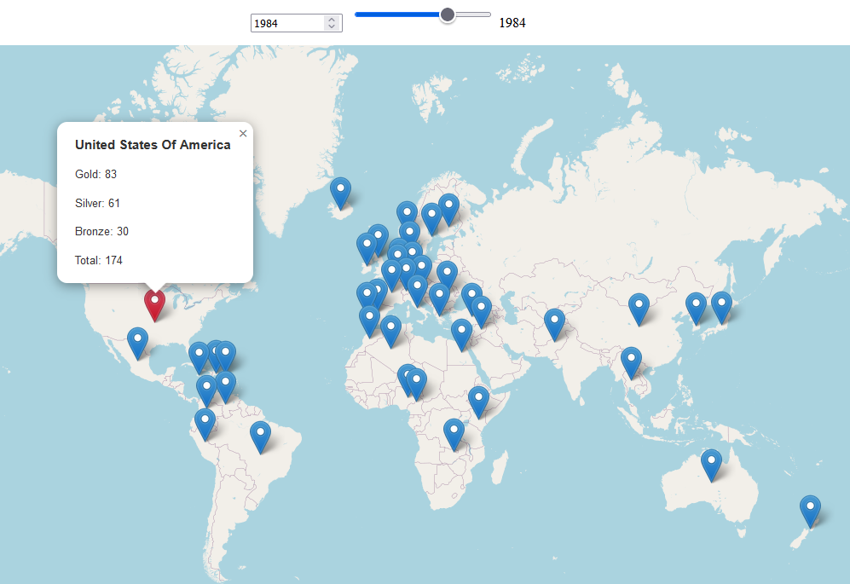
United States not participating in the 1980 Olympics (Moscow)
Soviet Union not participating in the 1984 Olympics (Los Angeles)

Slide 7
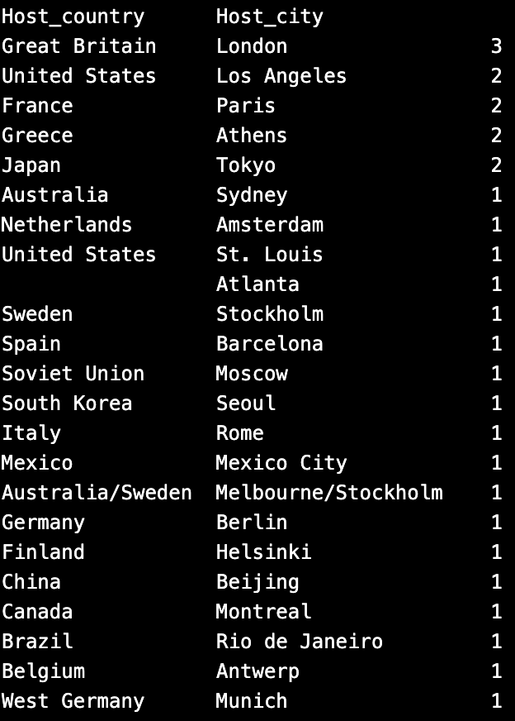
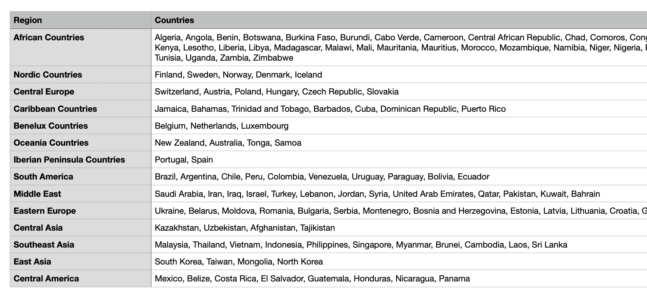
Total Unique Country Winners: 157!

Slide 8
The Role of GDP and Population in Medal Success
Economic Power as a Key Factor
Population Alone is Insufficient Data
Notes:
The reunification of Germany brought together two strong Olympic teams, but overall medal counts slightly declined due to competition from newly independent countries.S
Hypotheses, Inferences, and Key Factors
• Economic Power as a Key Factor
• Higher GDP may predict greater Olympic success due to better resources.
• Population Alone is Insufficient
• A large population doesn’t guarantee Olympic success; infrastructure and support are crucial.
• Sport-Specific Success
• GDP or population might have more impact on certain sports depending on cultural focus.
• USA as an Outlier
• High medal counts due to GDP, sports culture, and infrastructure.
• Visualization without the USA might reveal clearer patterns for other countries.
• Factors to Consider
• GDP: Availability of resources for sports development.
• Population: Potential talent pool.
• Sports Infrastructure: Facilities, training, and coaching.
• Cultural Emphasis: National interest in specific sports.
• Government Support: Influence of state-sponsored programs and initiatives.
Notes Section for Presentation:
• Economic Power: Emphasize that countries with higher GDP often have the resources to invest heavily in sports, leading to higher Olympic success. This is particularly evident in countries like China, where economic growth has paralleled increased medal counts.
• Population Alone: Point out that despite a large population, countries like India struggle in the Olympics due to inadequate infrastructure and a focus on sports outside the Olympic spectrum. Highlight that quality over quantity matters.
• Sport-Specific Success: Discuss how GDP or population might influence success differently depending on the sport and cultural priorities. For instance, a country might excel in a few sports due to targeted investments.
• USA as an Outlier: Explain that the USA’s consistent high medal count can skew the overall analysis. By removing it from visualizations, we can better understand trends among other countries.
• Key Factors: Summarize the critical factors influencing Olympic success:
• GDP: More resources lead to better facilities and training.
• Population: A larger talent pool, but not a guarantee of success.
• Sports Infrastructure: The backbone of athlete development.
• Cultural Emphasis: Some sports are prioritized over others based on national interest.
• Government Support: State-sponsored programs can significantly impact performance.

Slide 9
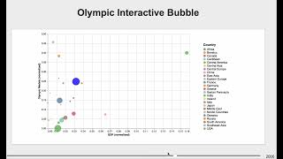
Hypothesis: GDP is a measure of Olympic success
Before 1984, China's presence in the Olympics was limited.
Rapid growth in GDP matches Olympic medal counts
The 2008 Beijing Olympics marked China's emergence as a leading sports nation, topping the gold medal tally.
Economic power and sporting success is demonstrated by China's rise as a major olympic competitor
Notes:
The post-Cold War era saw a broader range of countries winning medals, reflecting a more global and competitive Olympic field.
**China's Rising Olympic Success and GDP**
Rapid growth in Olympic medals and GDP since early 2000s.
Correlation between economic power and sporting success.
Government investment in sports infrastructure.
Important note, sports infrastructure
Takes time to teach and coach from an early age
Would expect to see continued growth as long as gdp is growing

Slide 10
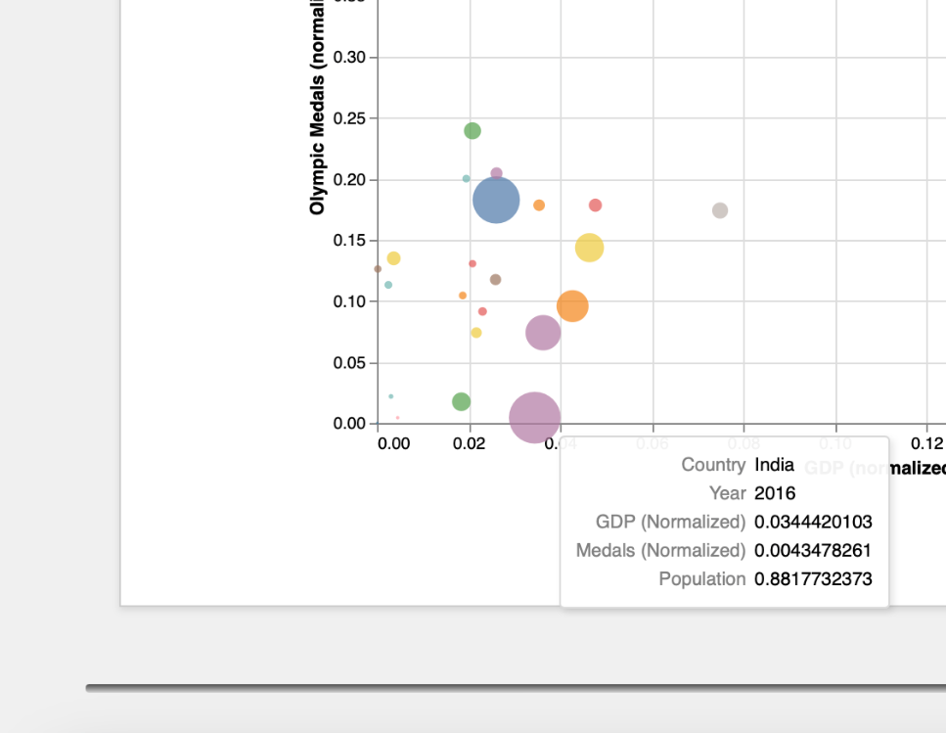
Hypothesis: Population size doesn’t matter to be successful in the Olympics
Despite a large population, India has historically underperformed in the Olympics.
Factors include limited funding for sports, lack of infrastructure, and a cultural focus on cricket.
Recent improvements have been seen in sports like badminton and wrestling.
Notes:
After 1990, the Olympics became less dominated by a few superpowers, with more countries and regions earning medals.
**India’s Population vs. Medal Count**
Large population but low Olympic medal count.
Limited sports infrastructure and cultural emphasis on non-Olympic sports.
Quality of sports programs matters more than population size.

